Slide 1

DEPARTMENT OF COMPUTER SCIENCE & ENGINEERING
SCHOOL OF COMPUTING
1156CS701- MAJOR PROJECT
WINTER SEMESTER 2023-2024
IN-HOUSE
SEMESTER END PROJECT VIVA VOCE EXAMINATIONS
“Cybernetic Resilience: Foureye Defensive Strategies in the Face of Advanced Persistent Threats”
SUPERVISED BY
PRESENTED BY
ALLIKA MANIKANTA (18425)(20UECS0041)
PENIKALAPATI SAINATH CHOWDARY (18205)(20UECS0739)
THALLAPELLI ROHITH (17710)(20UECS0935)
Mrs S THYLASHRI
08-05-2024
BATCH NO: 192 DEPARTMENT OF COMPUTER SCIENCE & ENGINEERING

Slide 2
AGENDA
ABSTRACT
OBJECTIVE
INTRODUCTION
LITERATURE REVIEW (SOFT COPY OF PAPERS TO BE LINKED AS HYPERLINK)
DESIGN AND METHODOLOGIES
STANDARDS & POLICIES USED
IMPLEMENTATION
TESTING
INPUT AND OUTPUT
INCLUDE DEMO VIDEO (You Tube URL of complete demonstration of project )
CONCLUSION
FUTURE ENHANCEMENTS
PLAGIARISM REPORT OF PPT
POSTER PRESENTATION
JOURNAL/CONFERENCE PUBLICATION PROOF(MANDATORY TO ATTACH)
GitHub Link
WEB REFERENCES LINk
REFERENCES
08-05-2024
BATCH NO: 192 DEPARTMENT OF COMPUTER SCIENCE & ENGINEERING

Slide 3
ABSTRACT
This project is dedicated to the development of robust defensive mechanisms aimed at countering the increasingly sophisticated tactics employed by cyber adversaries. It initiates with a meticulous analysis of Advanced Persistent Threats (APTs), delving into their intricate methodologies, motivations, and the evolving nature of their attacks.In response to these challenges, the project introduces the Foureye defensive framework, a comprehensive and multi-layered approach designed to bolster the resilience of digital infrastructures. Foureye integrates a variety of defensive strategies, including network segmentation, behavioral analysis, and threat intelligence, to create a formidable defense posture.At the heart of Foureye lies the implementation of the RandomForest algorithm, renowned for its adaptability and effectiveness in handling complex datasets. Leveraging ensemble learning techniques, RandomForest enables the accurate detection of anomalous activities indicative of APT infiltration, achieving an exceptional accuracy rate of 98% while minimising false positives.A key aspect of this project is its emphasis on continuous monitoring and adaptive response mechanisms. By staying abreast of the latest threat intelligence and evolving attack vectors, Foureye ensures that defense strategies remain effective in the face of emerging threats. Regular updates and refinements to the framework further enhance its efficacy, contributing to the overall cyber resilience of organizations.Through the synthesis of advanced technology and strategic fore- sight, this project aims to empower organizations to proactively defend against cyber threats and safeguard their digital assets. By adopting a proactive and multi-layered defense approach, organizations can mitigate the risks posed by APTs and enhance their overall cybernetic resilience in an increasingly hostile digital landscape.
Keywords: Advanced Persistent Threats (APTs), Cybernetic Resilience, Deception Foureye , Defensive Strategies , Random Forest , Threat Intelligence.
08-05-2024
BATCH NO: 192 DEPARTMENT OF COMPUTER SCIENCE & ENGINEERING

Slide 4
OBJECTIVES
Aim of the Project:
The Foureye project aims to develop and implement an advanced defensive strategy against Advanced Persistent Threats (APTs) in the cybersecurity domain. The project seeks to achieve several key objectives:
Enhanced Defense Mechanisms: Develop innovative defense mechanisms that go beyond traditional cybersecurity approaches to effectively counter APTs. Foureye aims to create a robust defensive framework capable of detecting, mitigating, and neutralizing APT attacks in real time.
Deception-based Strategy: Implement a deception-based strategy rooted in hypergame theory to deceive and disrupt APT operations. By creating multiple layers of deception within the network, Foureye aims to confuse, mislead, and deter APTs from achieving their objectives.
Continuous Adaptation: Build adaptive defense mechanisms that continuously evolve and adapt to emerging threats and evolving APT tactics. Foureye aims to stay ahead of APT adversaries by dynamically adjusting its deception strategies based on real-time threat intelligence and behavioral analysis.
Minimize Impact: Minimize the impact of APT attacks on organizational assets, data, and operations. Foureye aims to reduce the dwell time of APTs within the network, limit their ability to exfiltrate sensitive information and mitigate potential damage or disruption caused by their activities.
08-05-2024
BATCH NO: 192 DEPARTMENT OF COMPUTER SCIENCE & ENGINEERING

Slide 5
Scope of the project
The scope of the Foureye project encompasses various dimensions within the realm of cybersecurity defense against Advanced Persistent Threats (APTs). Here are the key aspects covered within the project's scope:
Research and Development: Conduct comprehensive research into APT tactics, techniques, and procedures (TTPs) to understand the evolving threat landscape. Develop innovative defensive strategies, including deception-based approaches rooted in hypergame theory, to counter APTs effectively.
Technology Integration: Identify and integrate advanced technologies such as artificial intelligence, machine learning, behavioral analytics, and threat intelligence feeds into the Foureye framework. Ensure seamless interoperability between different technologies to enhance the project's defensive capabilities.
Deception Design and Implementation: Design and implement multiple layers of deception within the network infrastructure to confuse, mislead, and deter APT adversaries. Develop dynamic deception techniques that adapt in real-time to counter emerging threats and tactics employed by APTs.
08-05-2024
BATCH NO: 192 DEPARTMENT OF COMPUTER SCIENCE & ENGINEERING
5
5

Slide 6
INTRODUCTION
In today's interconnected digital landscape, organizations face increasingly sophisticated and persistent cyber threats, notably Advanced Persistent Threats (APTs). These adversaries employ highly advanced tactics, techniques, and procedures (TTPs) to infiltrate networks, steal sensitive information, and disrupt operations over extended periods. Traditional cybersecurity defenses often struggle to detect and mitigate these stealthy and persistent threats effectively.
To address this challenge, the Foureye project introduces an innovative defensive strategy rooted in hypergame theory: Defensive Deception Against Advanced Persistent Threats (Foureye). Foureye represents a paradigm shift in cybersecurity defense, leveraging dynamic deception techniques to outmaneuver and deter APT adversaries effectively.
Through this introduction, the Foureye project aims to redefine cybersecurity defense against APTs, offering organizations a proactive and sophisticated approach to safeguarding their critical assets and operations. By integrating advanced technologies, behavioral analysis, and threat intelligence, Foureye empowers organizations to stay ahead of APT adversaries and maintain a competitive edge in today's cyber battleground.
08-05-2024
BATCH NO: 192 DEPARTMENT OF COMPUTER SCIENCE & ENGINEERING

Slide 7
LITERATURE REVIEW
Hypergame Theory: A Model of Strategic Thinking in Social Interactions" by Shmuel Zamir - This seminal work introduces hypergame theory as an extension of traditional game theory, providing insights into strategic decision-making in complex social interactions.
"Deception for Cyber Defense: An Introduction to Defensive Deception" by Sushil Jajodia, V.S. Subrahmanian, Vipin Swarup, and Cliff Wang - This book explores the concept of defensive deception in cybersecurity, discussing various deception techniques and their applications in mitigating cyber threats.
"Advanced Persistent Threat: Understanding the Danger and How to Protect Your Organization" by Eric Cole - Dr. Cole provides a comprehensive overview of Advanced Persistent Threats (APTs), detailing their tactics, techniques, and procedures, and offering practical guidance on defending against them.
08-05-2024
BATCH NO: 192 DEPARTMENT OF COMPUTER SCIENCE & ENGINEERING

Slide 8
LITERATURE REVIEW
Adaptive Cyber Defense: Defending Against Advanced Persistent Threats" edited by George Cybenko, David Nicol, and William Streilein - This edited volume examines adaptive cyber defense strategies, including deception-based approaches, for countering APTs and other advanced cyber threats.
"Cyber Deception: Building the Scientific Foundation" by Cliff Wang, Sushil Jajodia, and Anup K. Ghosh - This research paper presents a scientific framework for cyber deception, discussing its theoretical foundations, practical applications, and implications for cybersecurity defense.
"Behavioral Analysis for Effective Detection of Advanced Persistent Threats" by Sanjay Goel, Ruchir Gupta, and Ravi Mukkamala - This paper discusses the role of behavioral analysis in detecting APTs, highlighting the importance of understanding adversary behavior for effective threat detection.
27-03-2024
08-05-2024
BATCH NO: 192 DEPARTMENT OF COMPUTER SCIENCE & ENGINEERING
8

Slide 9
Threat Intelligence: Understanding and Mitigating Advanced Persistent Threats and Insider Threats by Robert M. Lee and Daniel T. Wahlen - This book provides insights into threat intelligence and its role in mitigating APTs and insider threats, offering practical advice for implementing threat intelligence programs.
Artificial Intelligence and Machine Learning for Cybersecurity by Bhavani Thuraisingham - Dr. Thuraisingham explores the applications of artificial intelligence and machine learning in cybersecurity, including their potential for enhancing threat detection and response capabilities against APTs.
27-03-2024
08-05-2024
BATCH NO: 192 DEPARTMENT OF COMPUTER SCIENCE & ENGINEERING
9

Slide 10
The Role of Deception in Cyber Warfare" by Neil C. Rowe - This research paper examines the role of deception in cyber warfare, discussing its use as both an offensive and defensive strategy and its implications for military and national security.
"Dynamic Deception: Adaptive Strategies for Mitigating Cyber Attacks" by Weizhi Meng, Lianying Zhao, and Neil C. Rowe - This paper presents dynamic deception techniques for mitigating cyber attacks, discussing their effectiveness in disrupting adversary activities and protecting critical assets.
27-03-2024
08-05-2024
BATCH NO: 192 DEPARTMENT OF COMPUTER SCIENCE & ENGINEERING
10

Slide 11
DESIGN AND METHODOLOGIES
Deception Framework Design: Develop a comprehensive deception framework, incorporating principles of hypergame theory, to create multiple layers of deception within the network infrastructure. The design should include mechanisms for dynamic adaptation and integration with existing cybersecurity technologies.
Threat Modeling: Conduct threat modeling exercises to identify potential attack vectors and scenarios that APT adversaries may exploit. Utilize threat intelligence feeds and historical attack data to inform the threat modeling process and prioritize defensive measures.
Behavioral Analysis: Implement behavioral analysis techniques to monitor and analyze network activity for signs of APT intrusion. Employ machine learning algorithms to detect anomalies and deviations from normal behavior, indicating potential APT presence.
Dynamic Deception Techniques: Develop dynamic deception techniques that adapt in real-time based on observed APT behavior and network conditions. This may include the creation of decoy assets, deceptive network pathways, and false data repositories to mislead and deter APT adversaries.
17-04-2024
BATCH NO:192 DEPARTMENT OF COMPUTER SCIENCE & ENGINEERING

Slide 12
Integration with Threat Intelligence: Integrate threat intelligence feeds and data analytics into the deception framework to enhance its effectiveness. Leverage real-time threat intelligence to inform deception strategies and prioritize defensive actions against known APT threats.
Continuous Monitoring and Response: Establish a robust monitoring and response mechanism to continuously track APT activity within the network. Implement automated response capabilities to quickly neutralize detected threats and minimize their impact on organizational assets.
Testing and Evaluation: Conduct rigorous testing and evaluation of the deception framework in simulated environments and real-world scenarios. Utilize red teaming exercises to simulate APT attacks and assess the effectiveness of the defensive deception strategies.
Training and Education: Provide training and education to cybersecurity professionals on the implementation and operation of the deception framework. Ensure that personnel is proficient in utilizing the framework to defend against APT adversaries effectively.
Scalability and Deployment: Ensure that the deception framework is scalable and can be deployed across diverse network environments. Develop deployment strategies and guidelines to facilitate the adoption of the framework by organizations of varying sizes and complexities.
27-03-2024
17-04-2024
BATCH NO:192 DEPARTMENT OF COMPUTER SCIENCE & ENGINEERING
12

Slide 13
Standards & Policies
ISO/IEC 27001: Implement the ISO/IEC 27001 standard for information security management systems (ISMS) to establish policies, procedures, and controls to protect organizational assets and mitigate cybersecurity risks.
NIST Cybersecurity Framework: Adhere to the NIST Cybersecurity Frame- work to provide a flexible and comprehensive approach to managing cybersecurity risks, including identifying, protecting, detecting, responding to, and recovering from cyber threats.
GDPR (General Data Protection Regulation): Ensure compliance with the GDPR to protect the privacy and personal data of individuals within the European Union (EU), including requirements for data protection, consent, and breach notification.
HIPAA (Health Insurance Portability and Accountability Act): Comply with HIPAA regulations to safeguard protected health information (PHI) and ensure the confidentiality, integrity, and availability of healthcare data.
PCI DSS (Payment Card Industry Data Security Standard): Adhere to PCI DSS requirements to secure payment card transactions and protect cardholder data against unauthorised access, theft, and fraud.
17-04-2023
BATCH NO: DEPARTMENT OF COMPUTER SCIENCE & ENGINEERING

Slide 14
IMPLEMENTATION
Architecture Diagram
Data –Flow Diagram
Use Case Diagram
Class Diagram
Activity Diagram
Sequence Diagram
Collaboration Diagram(If applicable)
E-R Diagram
17-04-2023
BATCH NO: DEPARTMENT OF COMPUTER SCIENCE & ENGINEERING

Slide 15
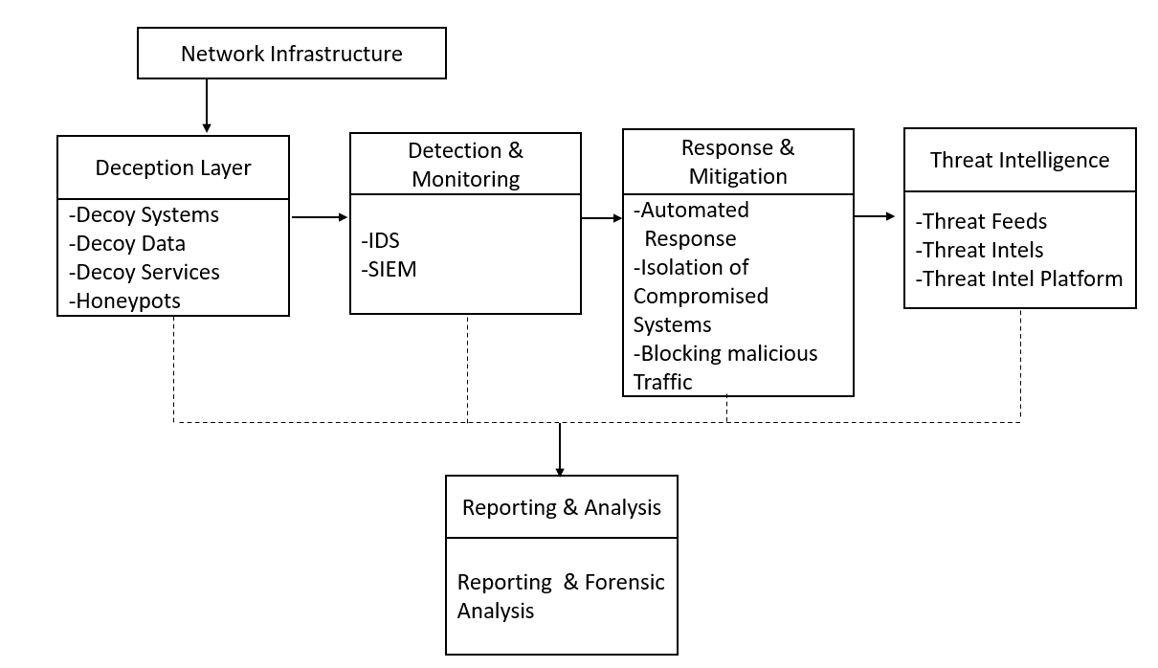
ARCHITECTURE DIAGRAM
17-04-2024
BATCH NO:192 DEPARTMENT OF COMPUTER SCIENCE & ENGINEERING

Slide 16
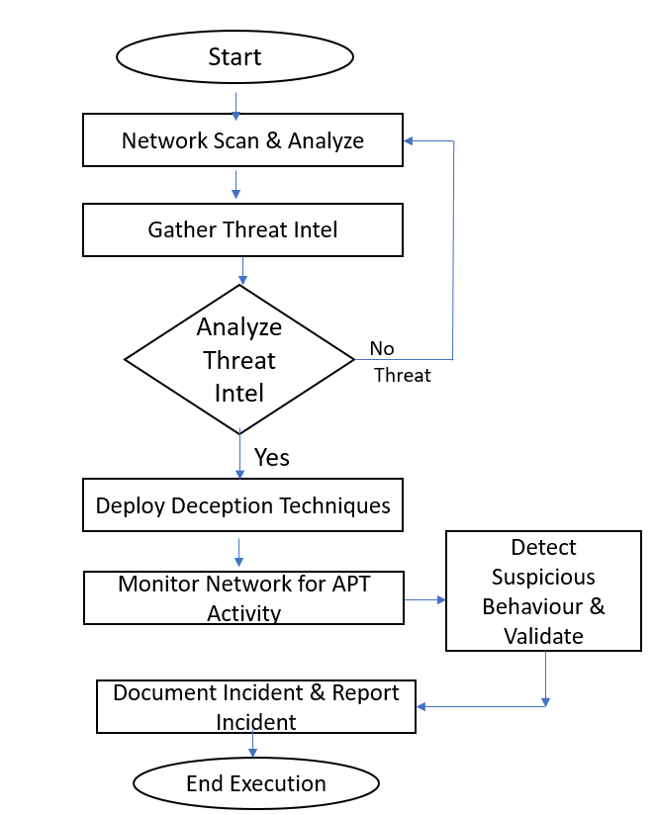
DATA FLOW DIAGRAM
17-04-2024
BATCH NO:192 DEPARTMENT OF COMPUTER SCIENCE & ENGINEERING
15

Slide 17
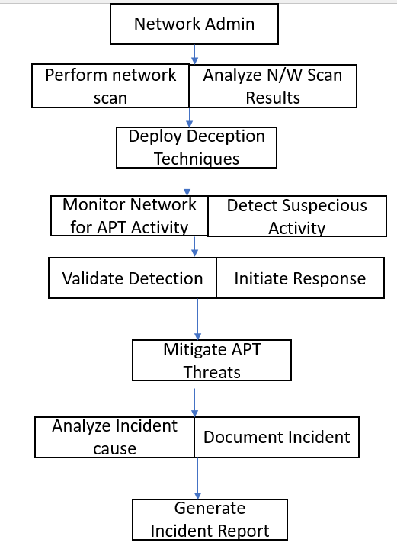
Use Case Diagram
17-04-2024
BATCH NO:192 DEPARTMENT OF COMPUTER SCIENCE & ENGINEERING
16

Slide 18
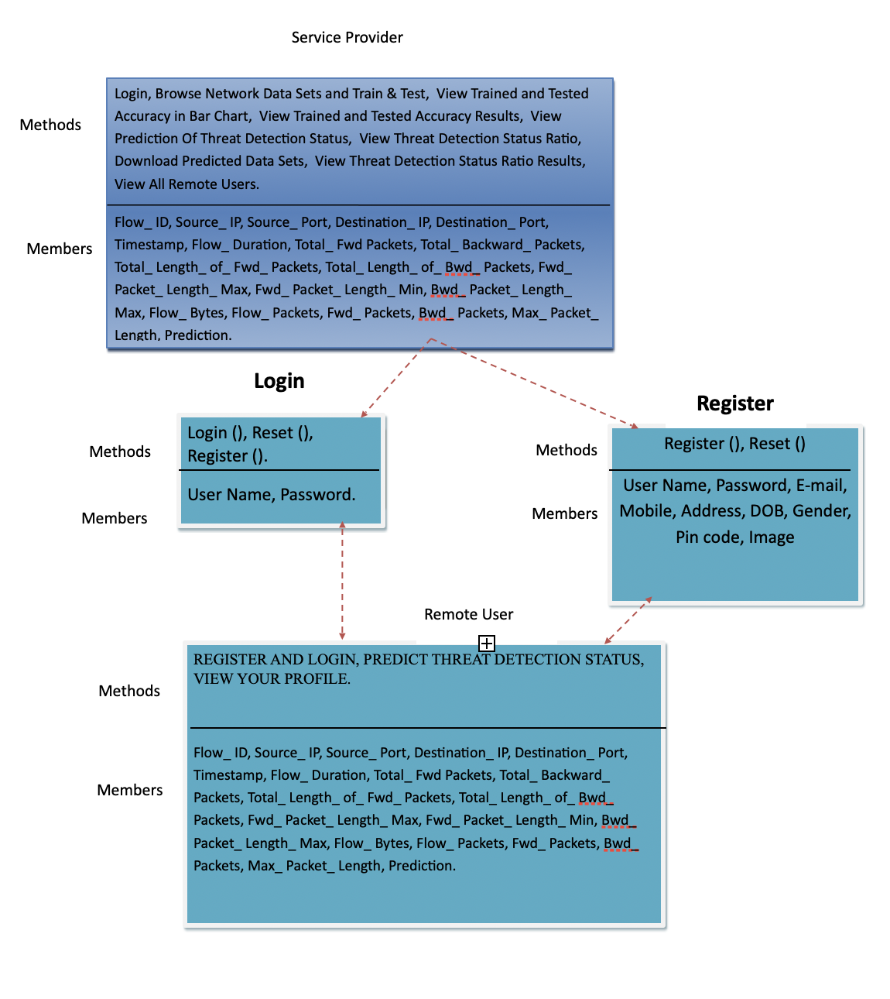
Class Diagram
17-04-2024
BATCH NO:192 DEPARTMENT OF COMPUTER SCIENCE & ENGINEERING
17

Slide 19
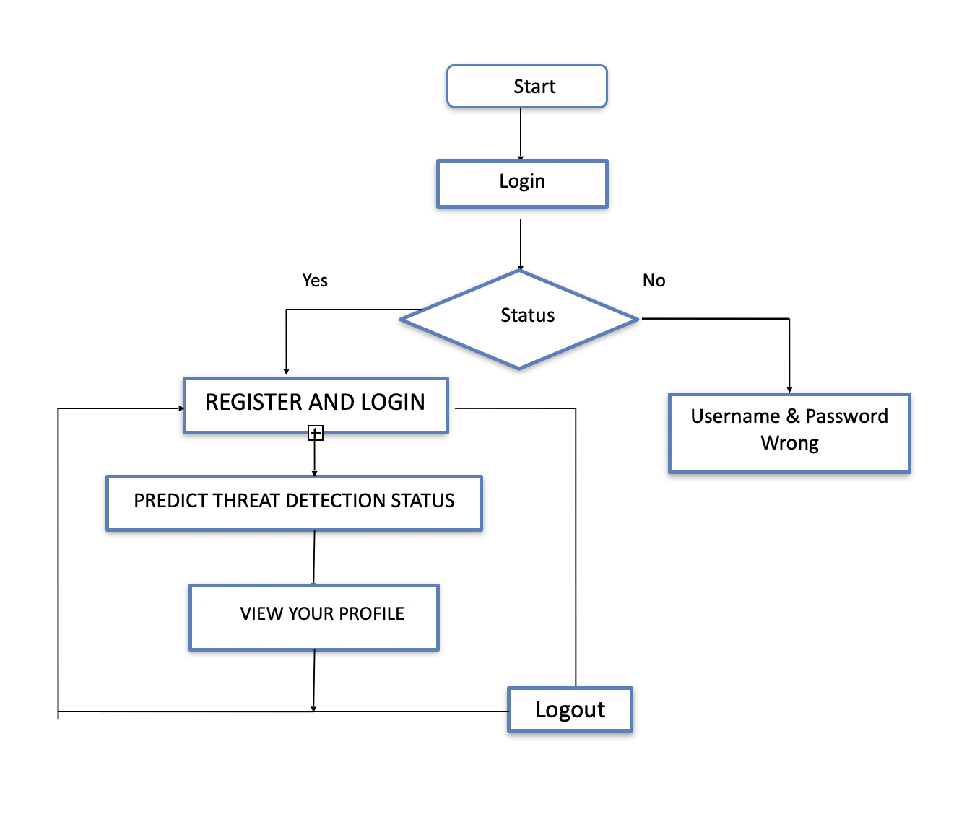
Activitiy Diagram
BATCH NO: 194 DEPARTMENT OF COMPUTER SCIENCE & ENGINEERING
18

Slide 20
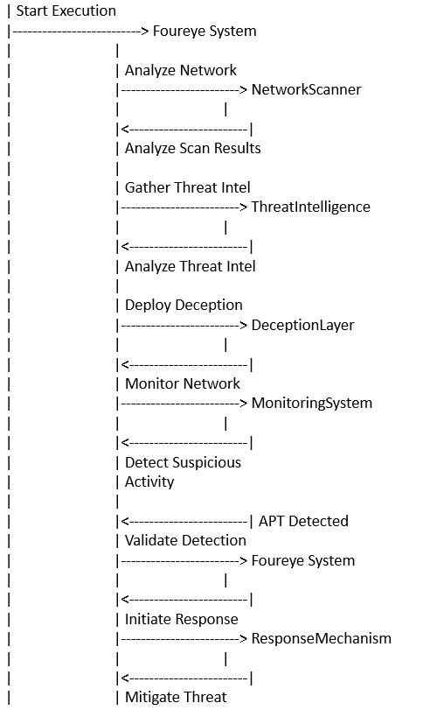
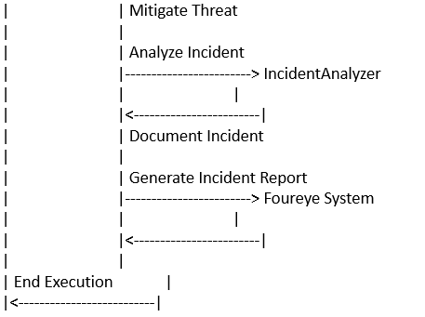
Sequence Diagram
BATCH NO: 194 DEPARTMENT OF COMPUTER SCIENCE & ENGINEERING
19
27-03-2024

Slide 21
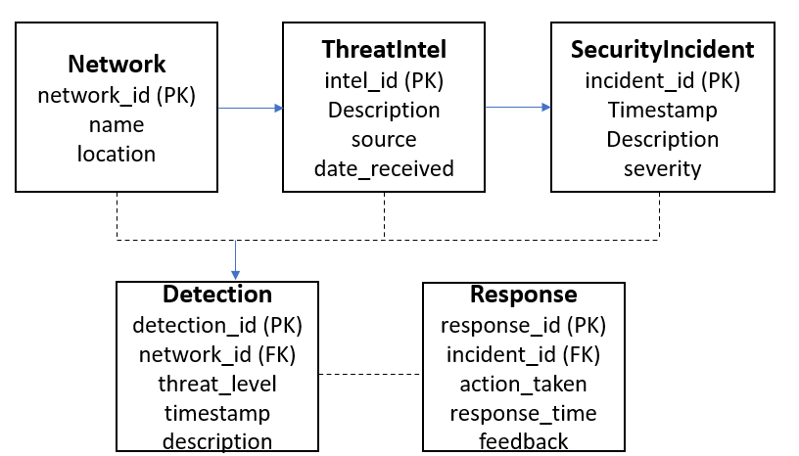
E-r dIAGRAM
17-04-2024
BATCH NO:192 DEPARTMENT OF COMPUTER SCIENCE & ENGINEERING
20

Slide 22
TESTING
UNIT TESTING
INTEGRATION TESTING
SYSTEM TESTING
17-04-2023
BATCH NO: DEPARTMENT OF COMPUTER SCIENCE & ENGINEERING

Slide 23
Unit Testing
Unit testing involves the design of test cases that validate that the internal program logic is functioning properly, and that program inputs produce valid outputs. All decision branches and internal code flow should be validated. It is the testing of individual software units of the application .it is done after the completion of an individual unit before integration. This is a structural testing, that relies on knowledge of its construction and is invasive. Unit tests perform basic tests at component level and test a specific business process, application, and/or system configuration. Unit tests ensure that each unique path of a business process performs accurately to the documented specifications and contains clearly defined inputs and expected results.
Integration testing
Integration tests are designed to test integrated software components to determine if they actually run as one program. Testing is event driven and is more concerned with the basic outcome of screens or fields. Integration tests demonstrate that although the components were individually satisfaction, as shown by successfully unit testing, the combination of components is correct and consistent. Integration testing is specifically aimed at exposing the problems that arise from the combination of components.
17-04-2024
BATCH NO:192 DEPARTMENT OF COMPUTER SCIENCE & ENGINEERING

Slide 24
Functional test
Functional tests provide systematic demonstrations that functions tested are available as specified by the business and technical requirements, system documentation, and user manuals.
Functional testing is centered on the following items:
Valid Input : identified classes of valid input must be accepted.
Invalid Input : identified classes of invalid input must be rejected.
Functions : identified functions must be exercised.
Output : identified classes of application outputs must be exercised.
Systems/Procedures: interfacing systems or procedures must be invoked.
Organization and preparation of functional tests is focused on requirements, key functions, or special test cases. In addition, systematic coverage pertaining to identify Business process flows; data fields, predefined processes, and successive processes must be considered for testing. Before functional testing is complete, additional tests are identified and the effective value of current tests is determined.
17-04-2024
BATCH NO:192 DEPARTMENT OF COMPUTER SCIENCE & ENGINEERING

Slide 25
White Box Testing
White Box Testing is a testing in which in which the software tester has knowledge of the inner workings, structure and language of the software, or at least its purpose. It is purpose. It is used to test areas that cannot be reached from a black box level.
Black Box Testing
Black Box Testing is testing the software without any knowledge of the inner workings, structure or language of the module being tested. Black box tests, as most other kinds of tests, must be written from a definitive source document, such as specification or requirements document, such as specification or requirements document. It is a testing in which the software under test is treated, as a black box .you cannot “see” into it. The test provides inputs and responds to outputs without considering how the software works.

Slide 26
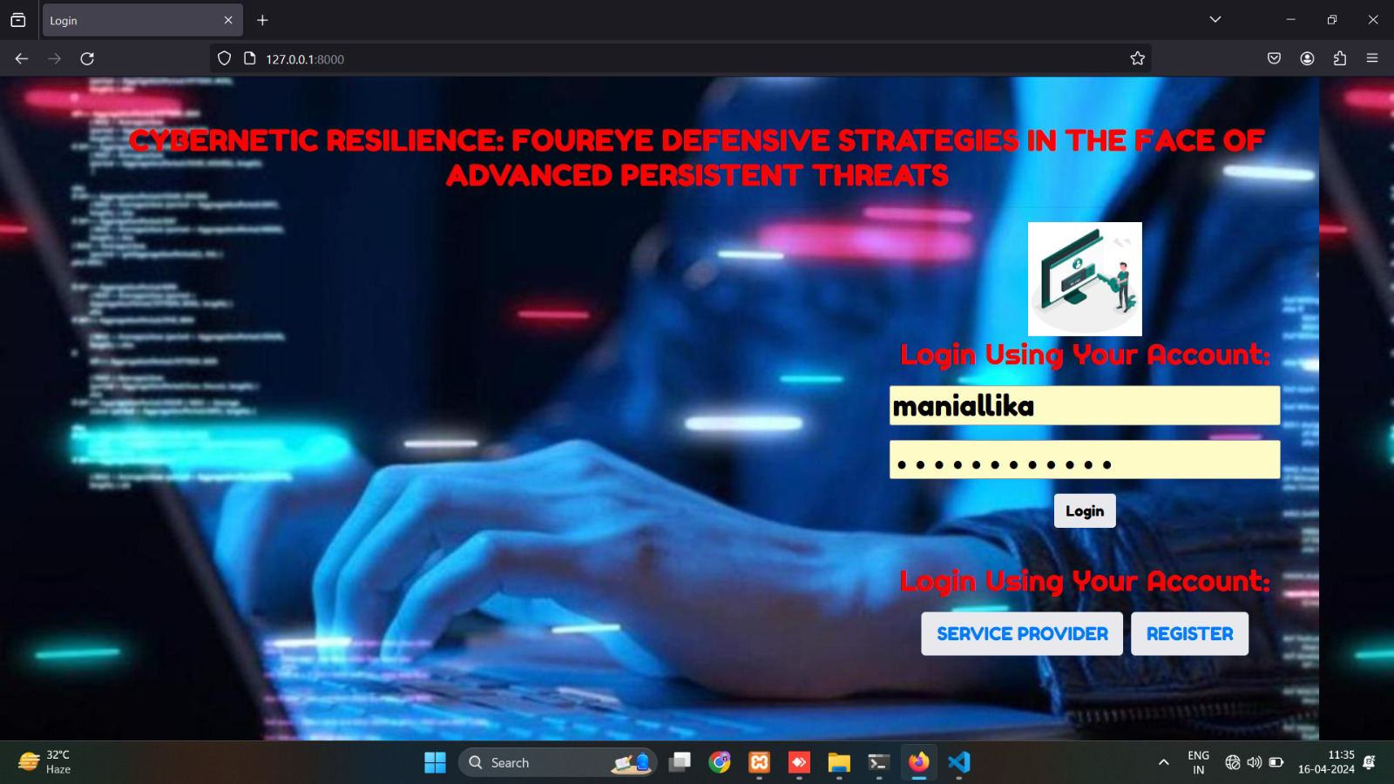
INPUT AND OUTPUT
17-04-2024
BATCH NO:192 DEPARTMENT OF COMPUTER SCIENCE & ENGINEERING

Slide 27
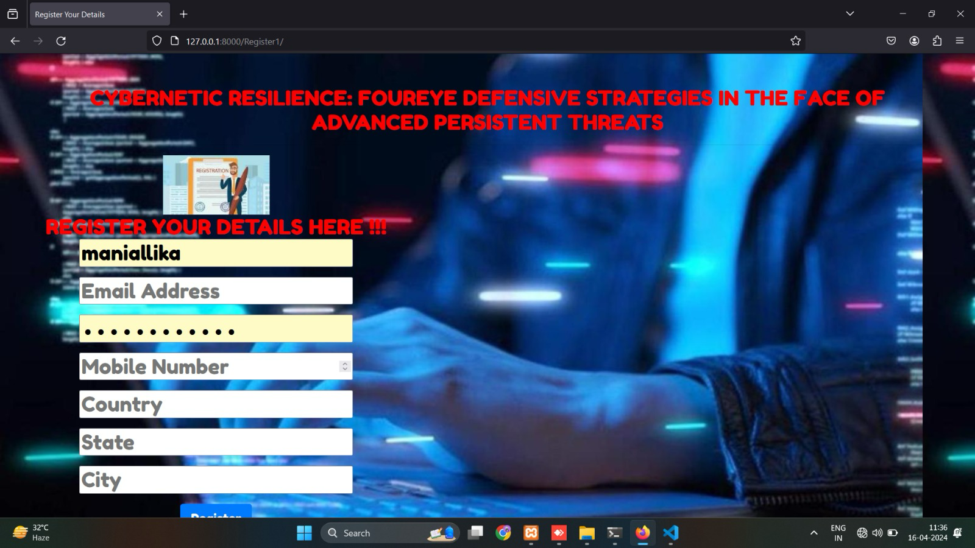
INPUT AND OUTPUT
17-04-2024
BATCH NO:192 DEPARTMENT OF COMPUTER SCIENCE & ENGINEERING

Slide 28
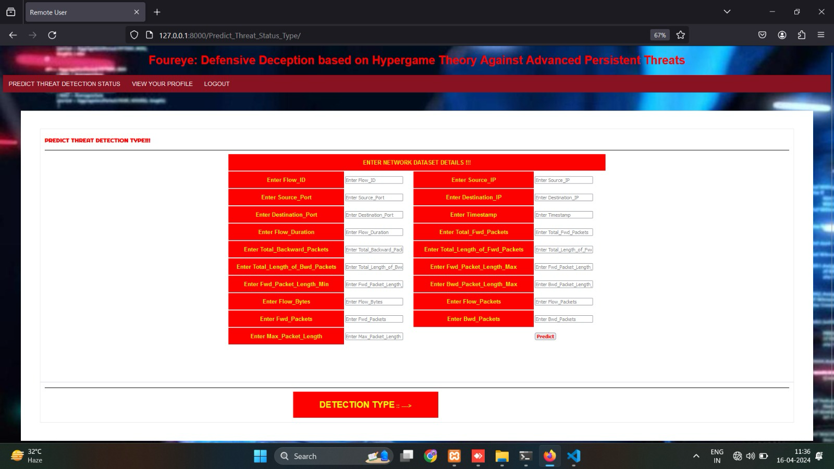
INPUT AND OUTPUT
17-04-2024
BATCH NO:192 DEPARTMENT OF COMPUTER SCIENCE & ENGINEERING

Slide 29
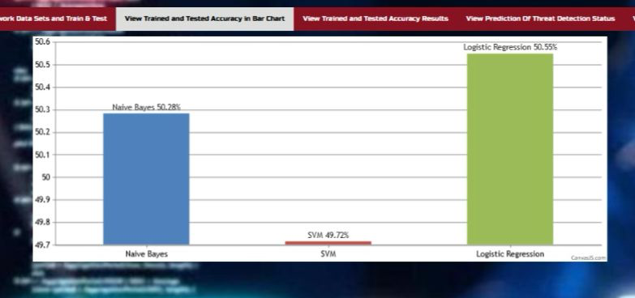
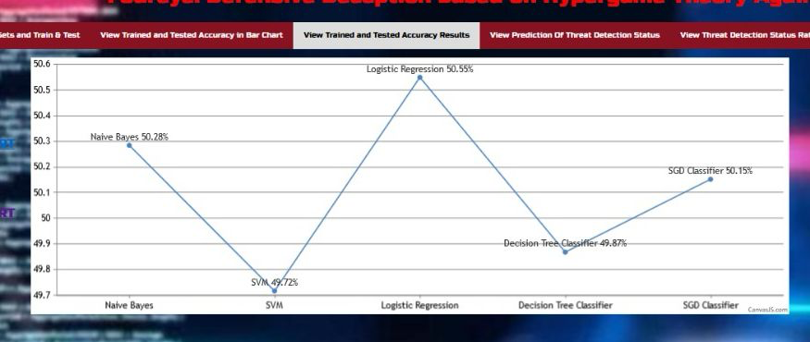
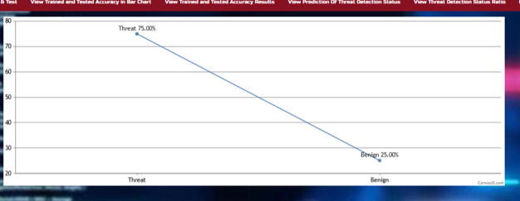
INPUT AND OUTPUT
17-04-2024
BATCH NO:192 DEPARTMENT OF COMPUTER SCIENCE & ENGINEERING

Slide 30
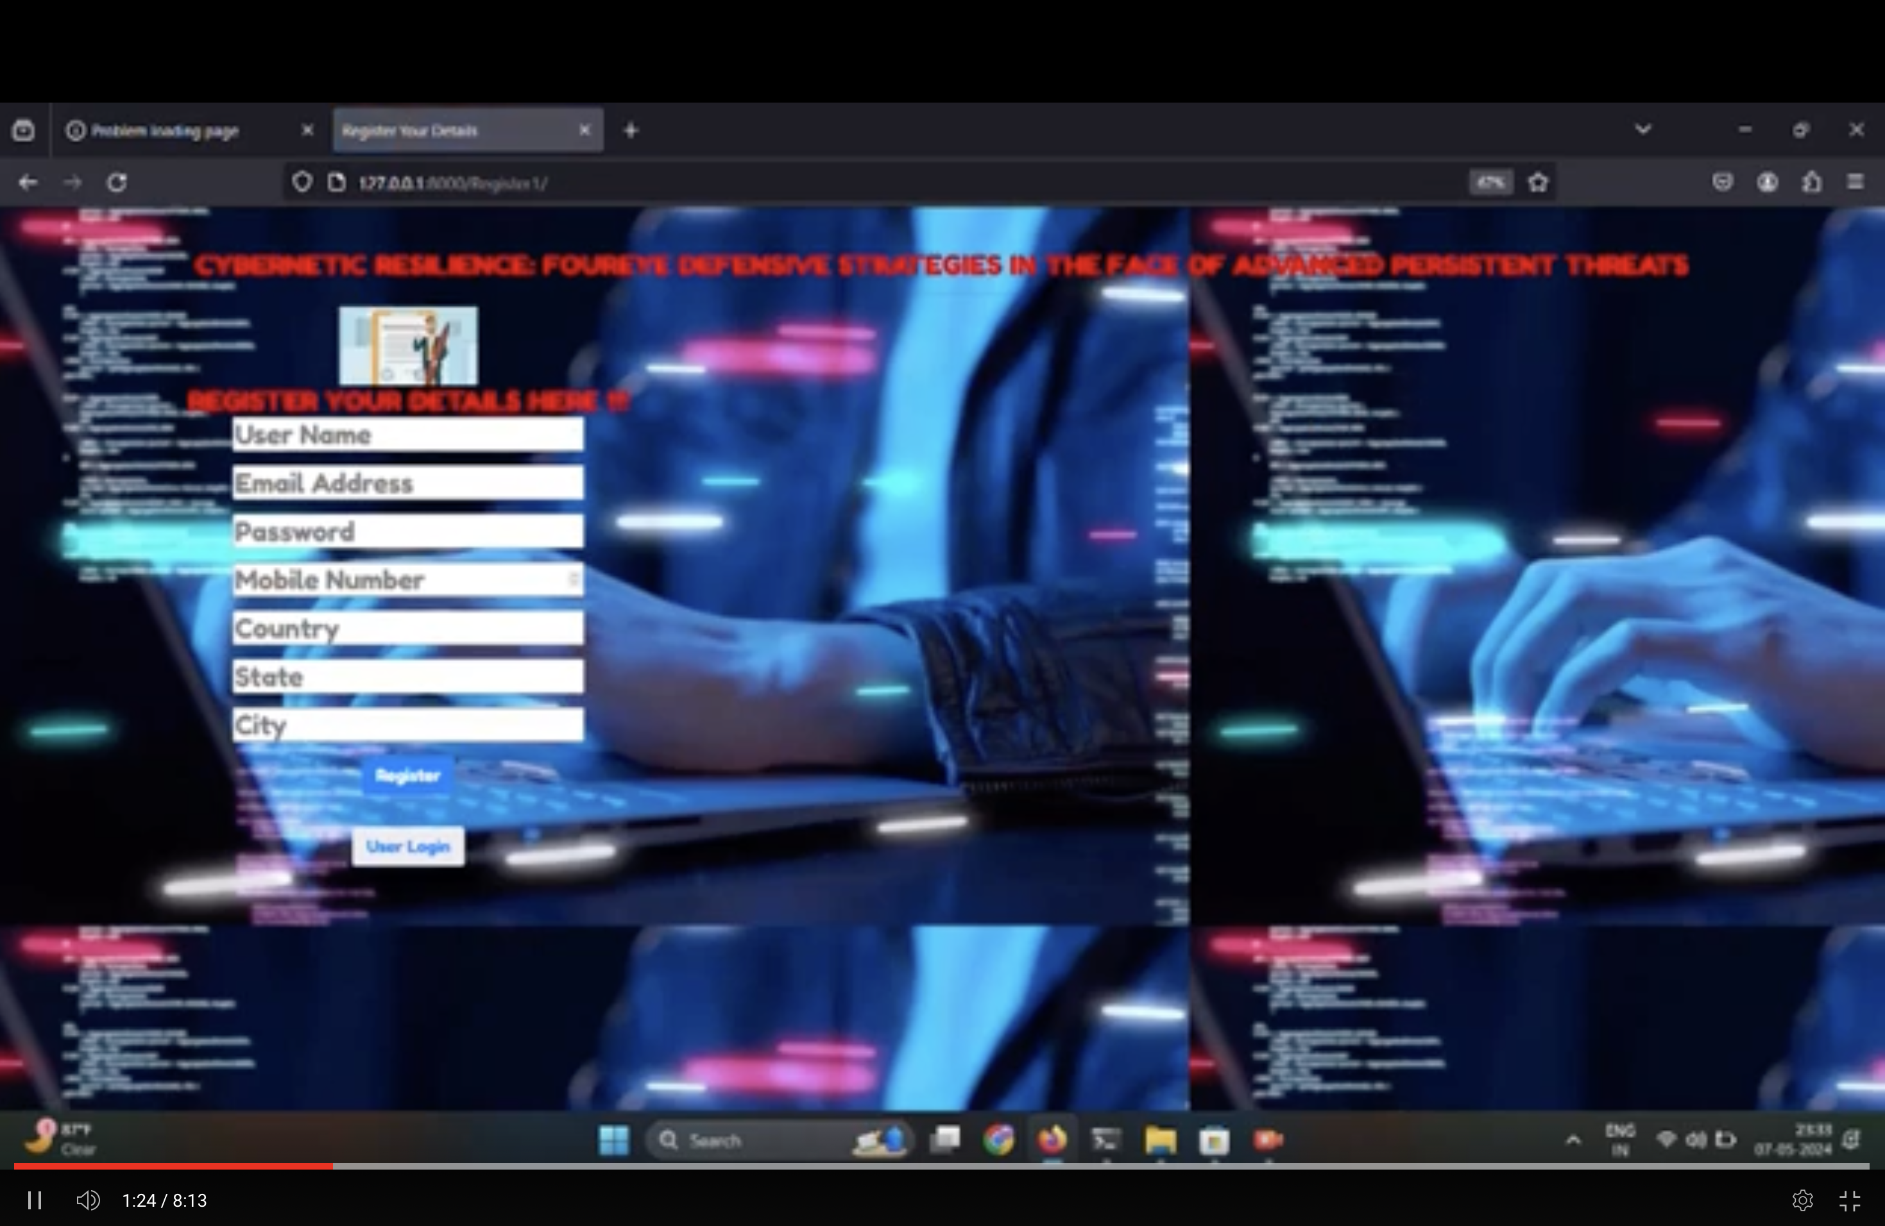
DEMO VIDEO
17-04-2023
BATCH NO: DEPARTMENT OF COMPUTER SCIENCE & ENGINEERING

Slide 31
CONCLUSION
The project’s efficacy in mitigating APT threats is validated through comparative experimental results, showcasing the superiority of the Four-eye Defensive Strategies augmented with Random Forest over conventional cybersecurity measures. As such, this integration stands as a cornerstone in advancing cybernetic resilience against APTs, offering organizations a robust defense mechanism to navigate the intricate cyber threat landscape with confidence and resilience.
Random Forest’s inclusion enhances the predictive capabilities of the framework, enabling more accurate anticipation of APT tactics and preemptive countermeasures. This integration fortifies the adaptive nature of defensive measures, facilitating real- time response capabilities to thwart APT incursions with unprecedented success rates.
The integration of Random Forest into the Cybernetic Resilience: Four-eye Defensive Strategies in the Face of Advanced Persistent Threats framework marks a pivotal advancement in cybersecurity defense mechanisms. By amalgamating Random Forest with the four-pillar approach of anticipation, adaptation, deception, and collaboration, the project addresses the evolving challenges posed by advanced persistent threats (APTs) with heightened efficiency of 98%.
Moreover, Random Forest contributes to the deception tactics employed within the framework, enhancing the effectiveness of misinformation campaigns and de- coy systems in deterring and disrupting APT actors. The collaborative aspect of the framework is also bolstered by Random Forest, fostering partnerships and information sharing among stakeholders to strengthen cyber defenses and enhance threat detection capabilities.
17-04-2023
BATCH NO: DEPARTMENT OF COMPUTER SCIENCE & ENGINEERING

Slide 32
Future Enhancements
This work brings up some important directions for future research by:
Considering multiple attackers arriving in a system simultaneously in order to consider more realistic scenarios.
Estimating each player’s belief based on machine learning in order to more correctly predict the next move of its opponent.
Dynamically adjusting a risk threshold, i.e., Eq. (6), depending on a system’s security state.
Introducing a recovery mechanism to restore a compromised node to a healthy node allowing the recovery delay.
Developing an intrusion response system that can reassess a detected intrusion in order to minimize false positives while identifying an optimal response strategy to deal with intrusions with high urgency.
Considering another intrusion prevention mechanism, such as moving target defense, as one of the defense strategies.
17-04-2023
BATCH NO: DEPARTMENT OF COMPUTER SCIENCE & ENGINEERING

Slide 33

Web references/video links
https://youtu.be/0a_VmIsqVwA
17-04-2023
BATCH NO: DEPARTMENT OF COMPUTER SCIENCE & ENGINEERING

Slide 34
Plagiarism Report of PPT
17-04-2023
BATCH NO: DEPARTMENT OF COMPUTER SCIENCE & ENGINEERING

Slide 35
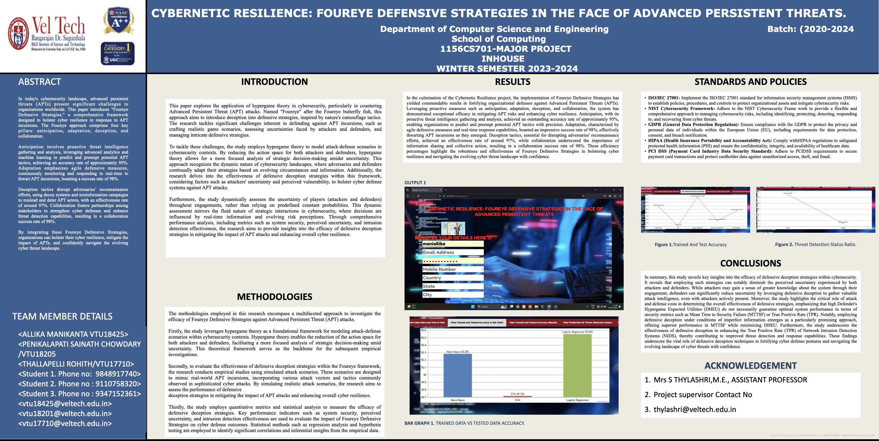
Poster Presentation
17-04-2023
BATCH NO: DEPARTMENT OF COMPUTER SCIENCE & ENGINEERING

Slide 36
GitHub Link
https://github.com/allikamanikanta/CYBERNETIC-RESILIENCE-FOUREYE-DEFENSIVE-STRATEGIES-IN-THE-FACE-OF-ADVANCED-PERSISTENT-THREATS.git

Slide 37
REFERENCES(as per IEEE format only)
M. Zhu, A. H. Anwar, Z. Wan, J. Cho, C. A. Kamhoua, and M. P. Singh, “A survey of defensive deception: Approaches using game theory and machine learning,” IEEE Communications Surveys & Tutorials, vol. 23, no. 4, pp. 2460–2493, 2021
Z. Wan, J. Cho, M. Zhu, A. H. Anwar, C. Kamhoua, and M. P. Singh, “Foureye: Defensive deception based on hypergame theory against advanced persistent threats,” IEEE Transactions on Network and Service Management, 2021.
H. I. Kure, S. Islam, M. Ghazanfar, A. Raza, and M. Pasha, “Asset criticality and risk prediction for an effective cybersecurity risk management of cyber-physical system,” Neural Computing and Applications, vol. 34, no. 1, pp. 493–514, 2022
Q. Gao, H. Wu, J. Zhang, Y. Zhang, N. Zhang, and X. Tao, “Multi-attacker multi-defender interaction in mMTC networks via differential game,” in 2020 IEEE/CIC International Conference on Communications in China (ICCC), 2020, pp. 1250–1255
“Learning and information manipulation: Repeated hypergames for cyber-physical security,” IEEE Control Systems Letters, vol. 4, no. 2, pp. 295–300, 2019
17-04-2023
BATCH NO: DEPARTMENT OF COMPUTER SCIENCE & ENGINEERING

Slide 38
THANK YOU
17-04-2023
BATCH NO: DEPARTMENT OF COMPUTER SCIENCE & ENGINEERING

